Slide 1
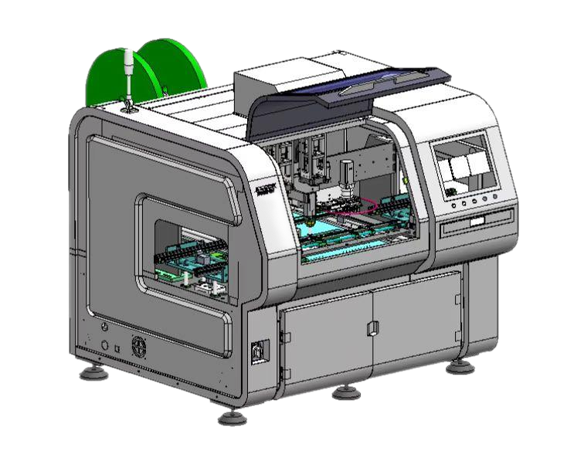
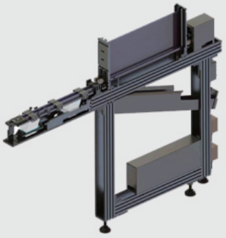
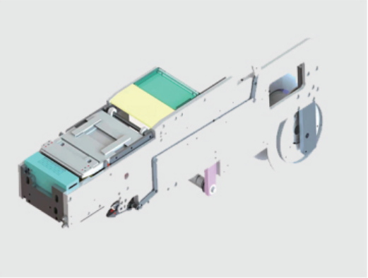
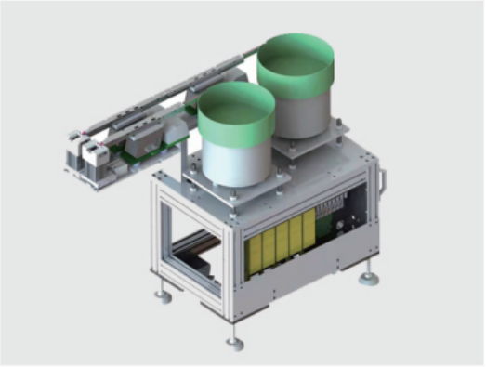
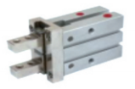
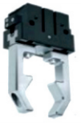
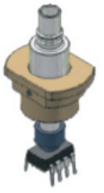
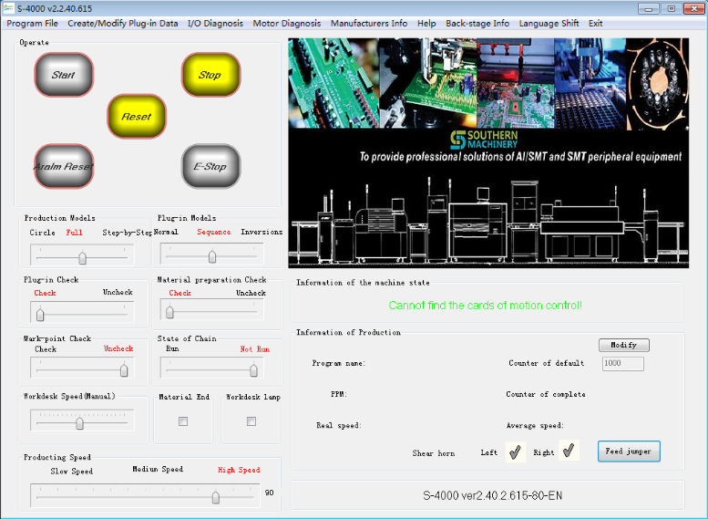

S7020 Series insertion machine
Feature:
S7020 Series Insertion Machine is designed and produced to insert components with special shape and dimension.
You only need to buy one to realize a full series of functions (just switch the feeder and gripper).
Unified Structure
Easy to operate, one day training can be fully mastered.
Unified Software
The same function, the price is only one-third of the Universal machine.
Super Cost-effective

Slide 2
S7020 Series Insertion Machine
Advantages of S7020 Series Insertion Machine
*One machine can replace at least 10 labors
*Price 30% lower than other brands
*Faster speed, lower maintenance cost,$500 monthly spare parts maintenanceother
*Simple operation, grasp with1 day training
— 7x24 Worldwide Support
— Free Installation/ Training
— 1 day lead-time (spare parts)
— 1 Month customize solution

Slide 3
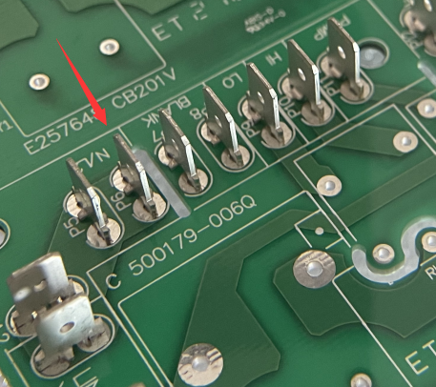
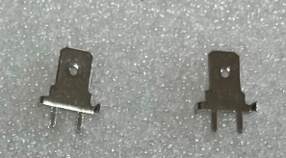
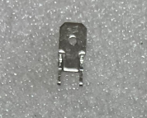
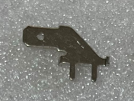

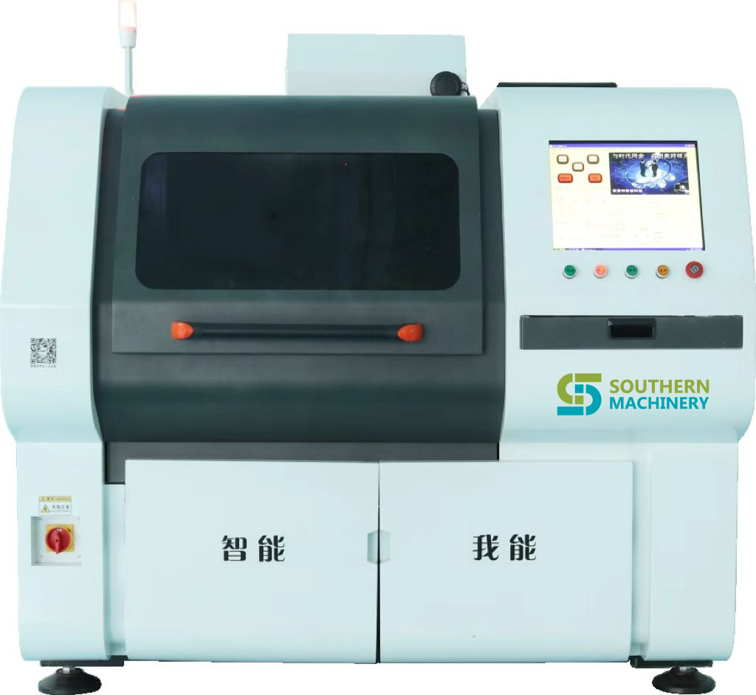
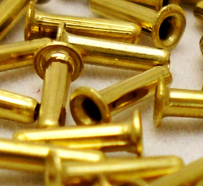
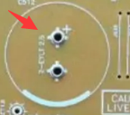
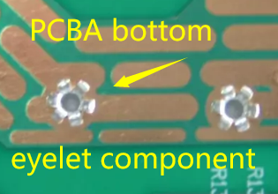
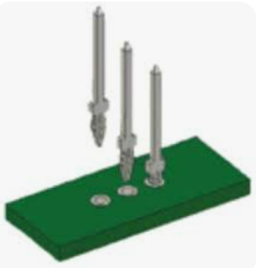
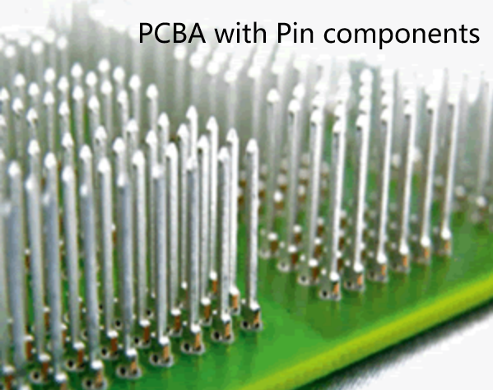
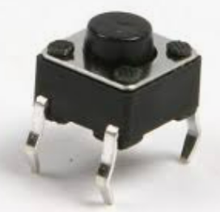
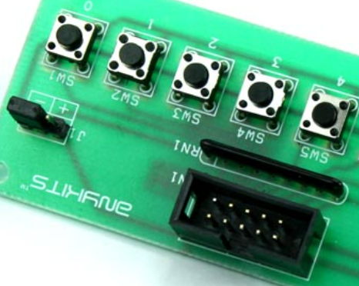
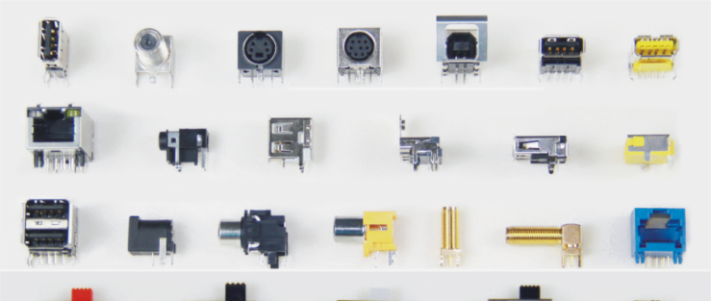
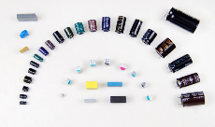
S7020 Series Insertion Machine
S7020 Series Insertion Machine including:
I 'll never say tired,
just need regular
maintenance !
1.S7020T Terminal Insertion machine (2 insertion heads and 2 reel feeders / or 2 bowl feeders)
2.S7020E Eyelet Insertion machine (2 insertion heads and 2 Bowl feeder)
3.S7020P PIN Insertion machine (2 insertion heads and 2 reel feeder / or 2 Bowl feeder)
4.S7020S Tact Switch Insertion machine (2 insertion heads and 2 Bowl feeder)
5.S7020F Oddform Insertion machine (2 insertion heads and 2 Bowl feeder /or 2 tube feeder)

Slide 4
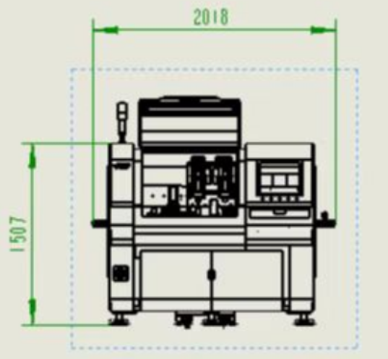

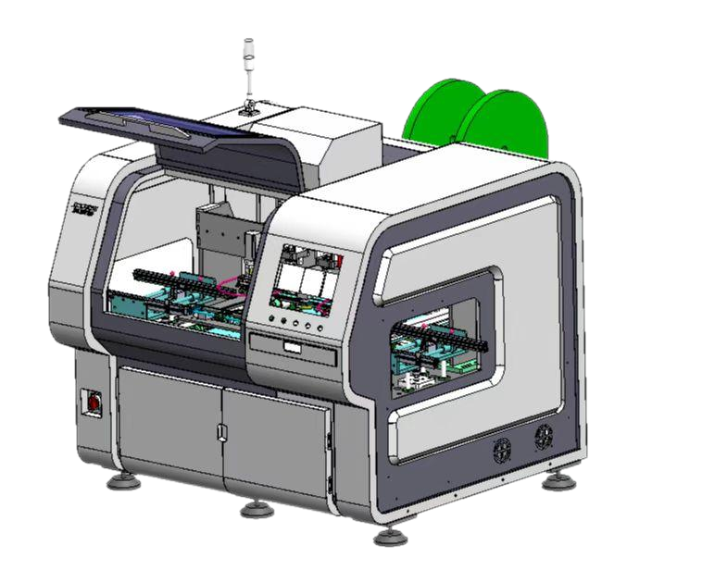
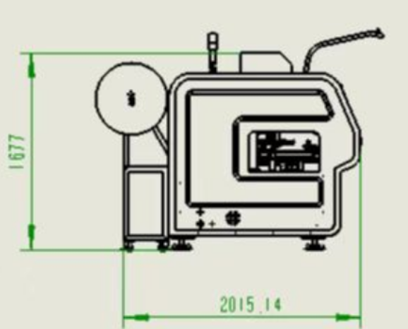
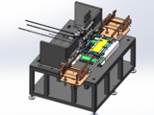
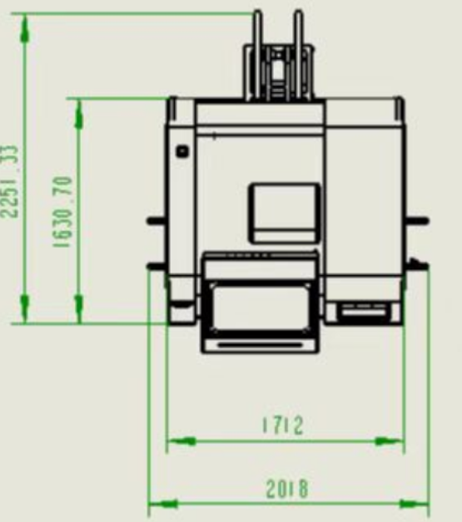
S7020 Series Insertion Machine
Structure
Reel feeder
Terminal mold

Slide 5
S7020 Series Insertion Machine
Insertion head
Feeder
Vision programming
Clinching base(PCB support & miss check)

Slide 6
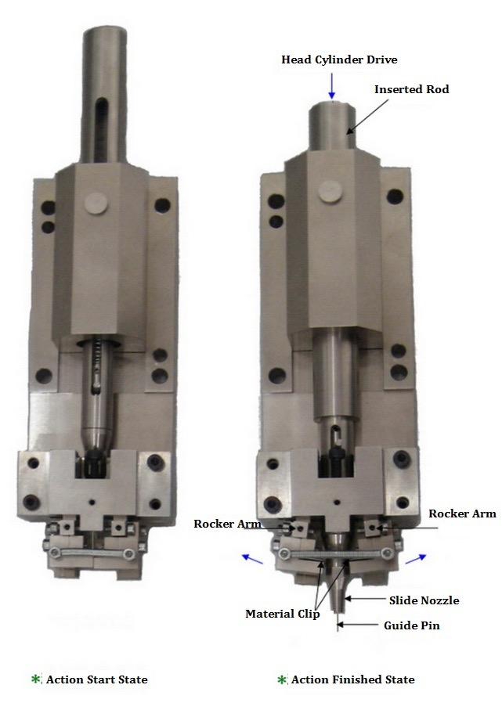
S7020 Series Insertion Machine
Machine Insertion Head ASSY
Connect to motor
Head driver
Programming camera
Nozzle
R cutter
L cutter
Pedestal

Slide 7
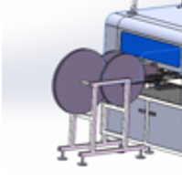
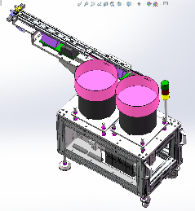
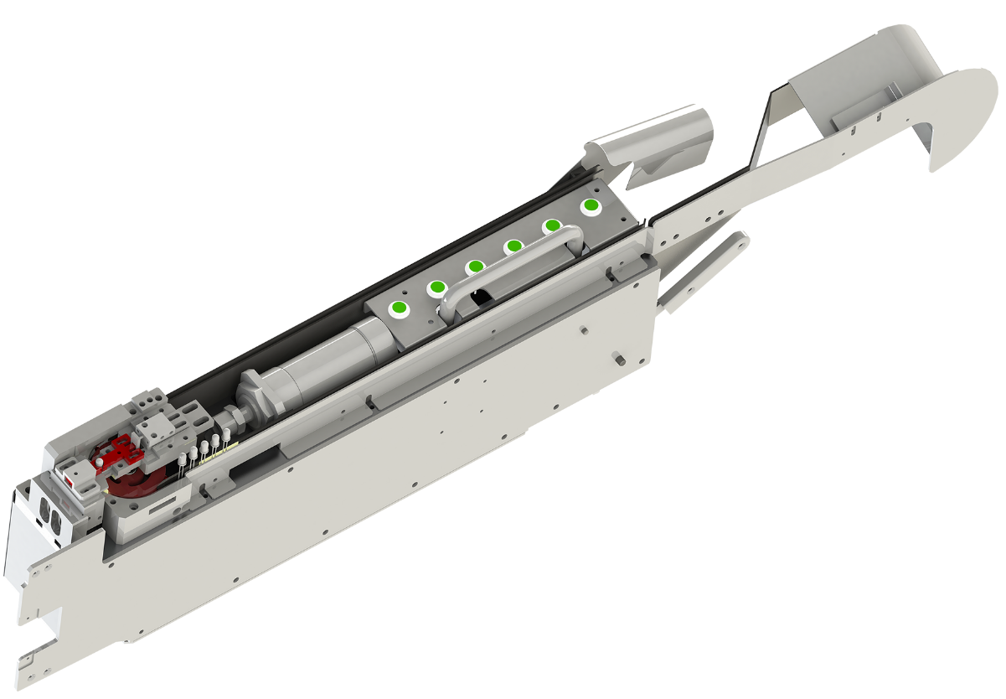
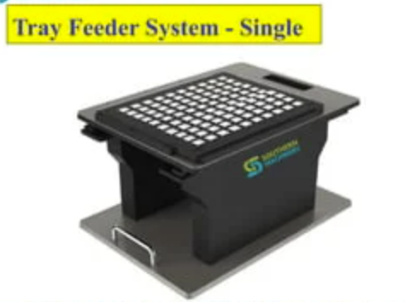
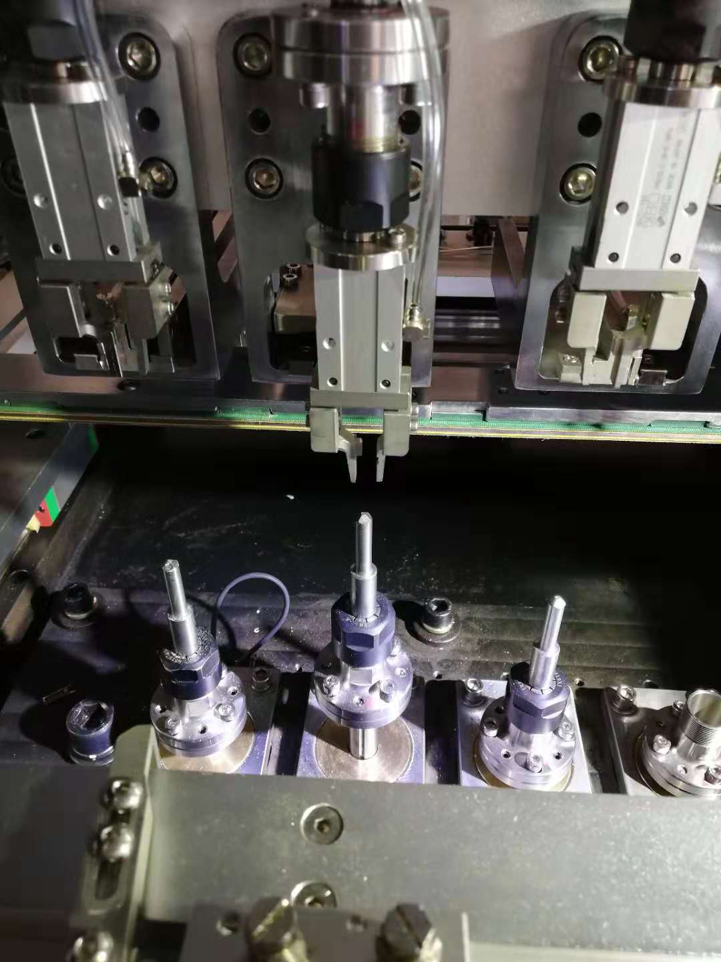
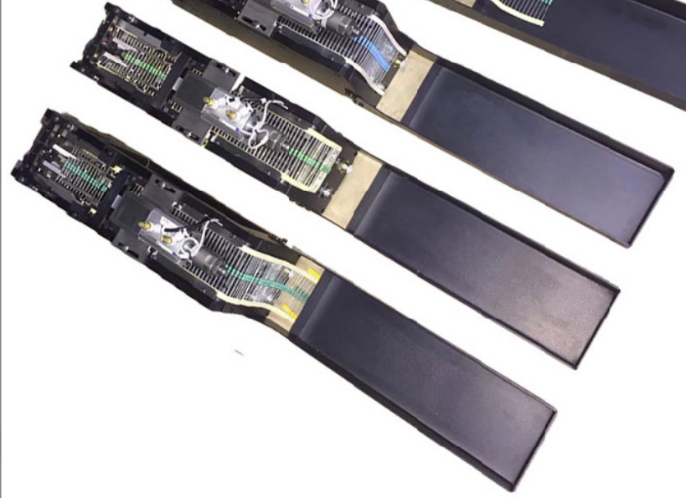
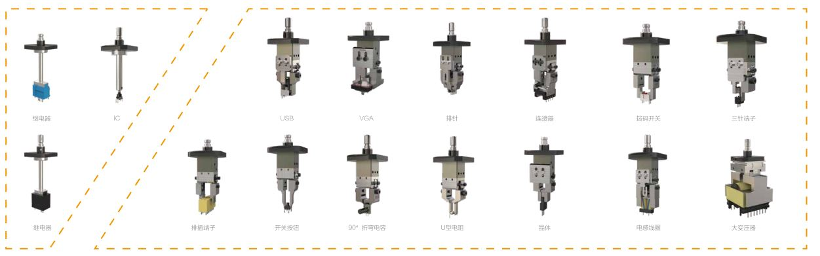
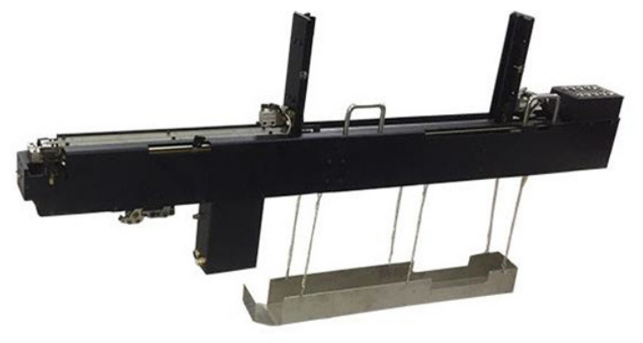
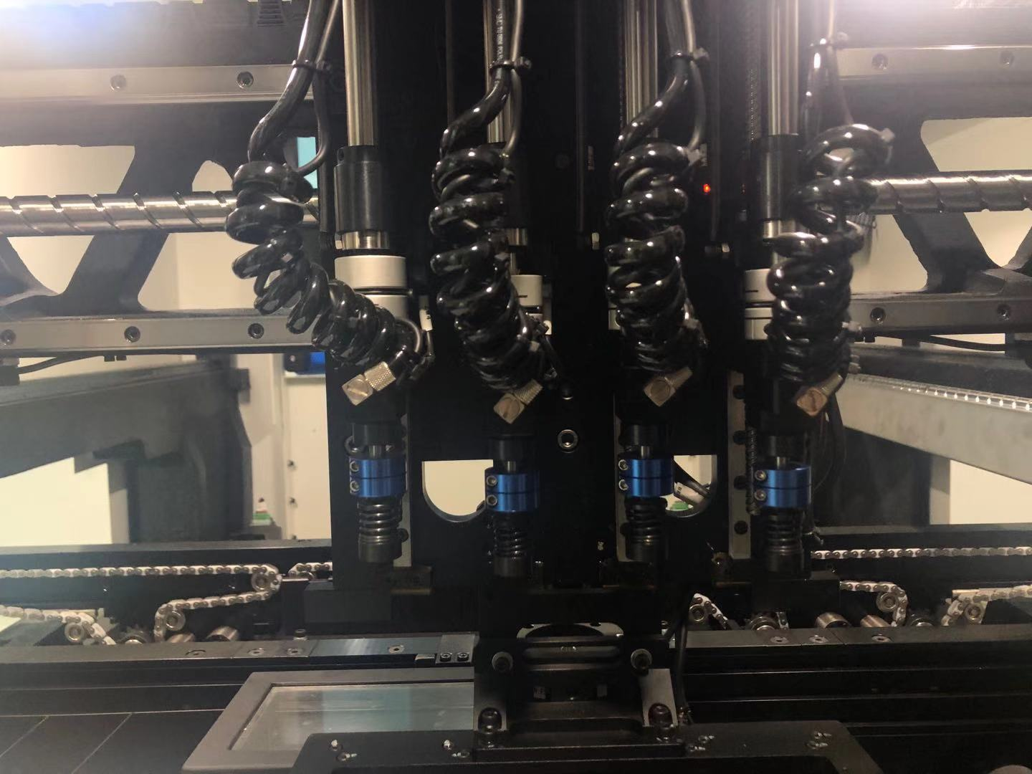
Feeding system
Design different feeders based on component package
Clinching system
S7020 Series Insertion Machine
If the detection system detects that the insertion has completed successfully Go to the next step, if it is not completed, the machine will stop and report an error.) After that, the X-Y workbench will send the PCB completed by the insertion to the right track
Insertion Head Gripper/Nozzle

Slide 8
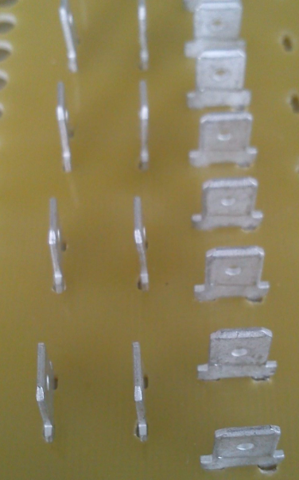
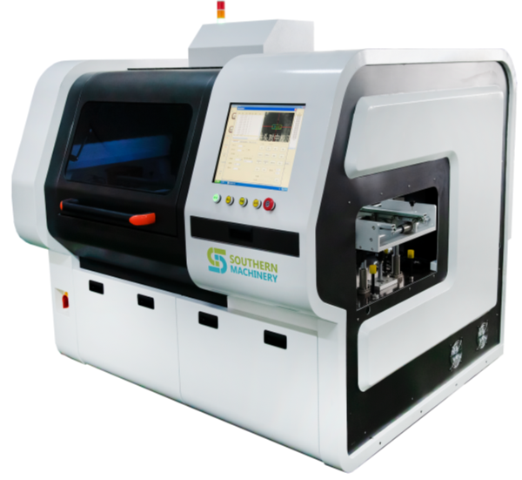
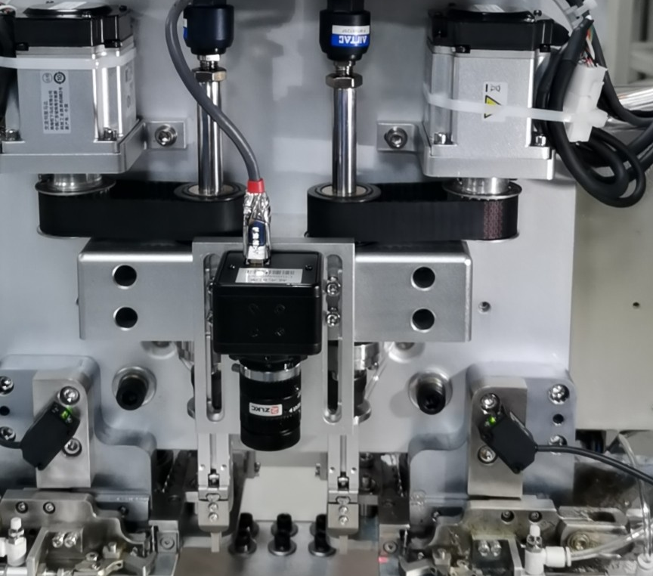
Detail Presentation about S7020T Terminal Insertion Machine
It is used to insert terminal components into a PCB automatically.
Applicable components: Terminal
2 insertion heads and 2 reel feeder/bowl feeder
S7020T
Speed:12000CPH

Slide 9
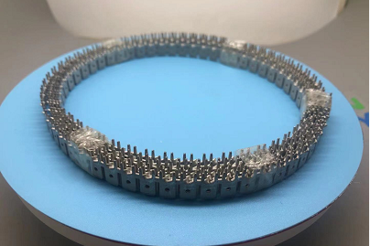
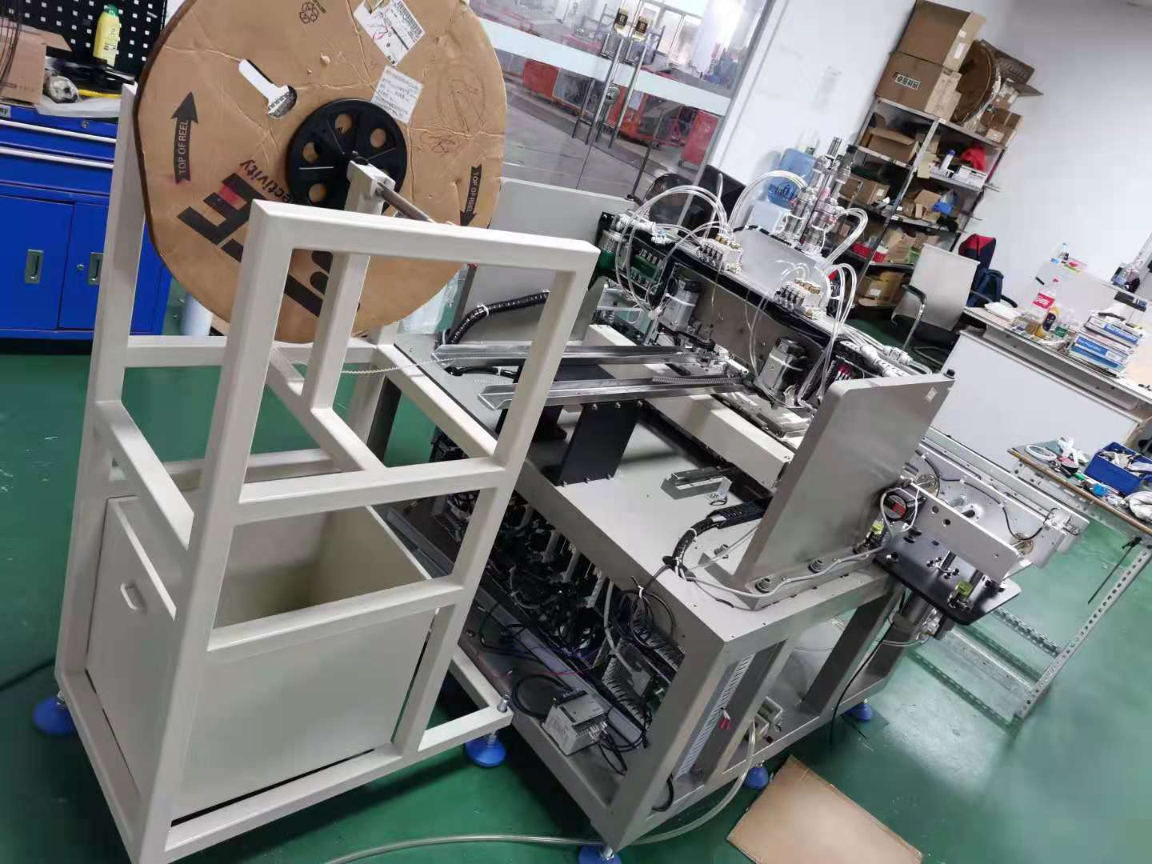
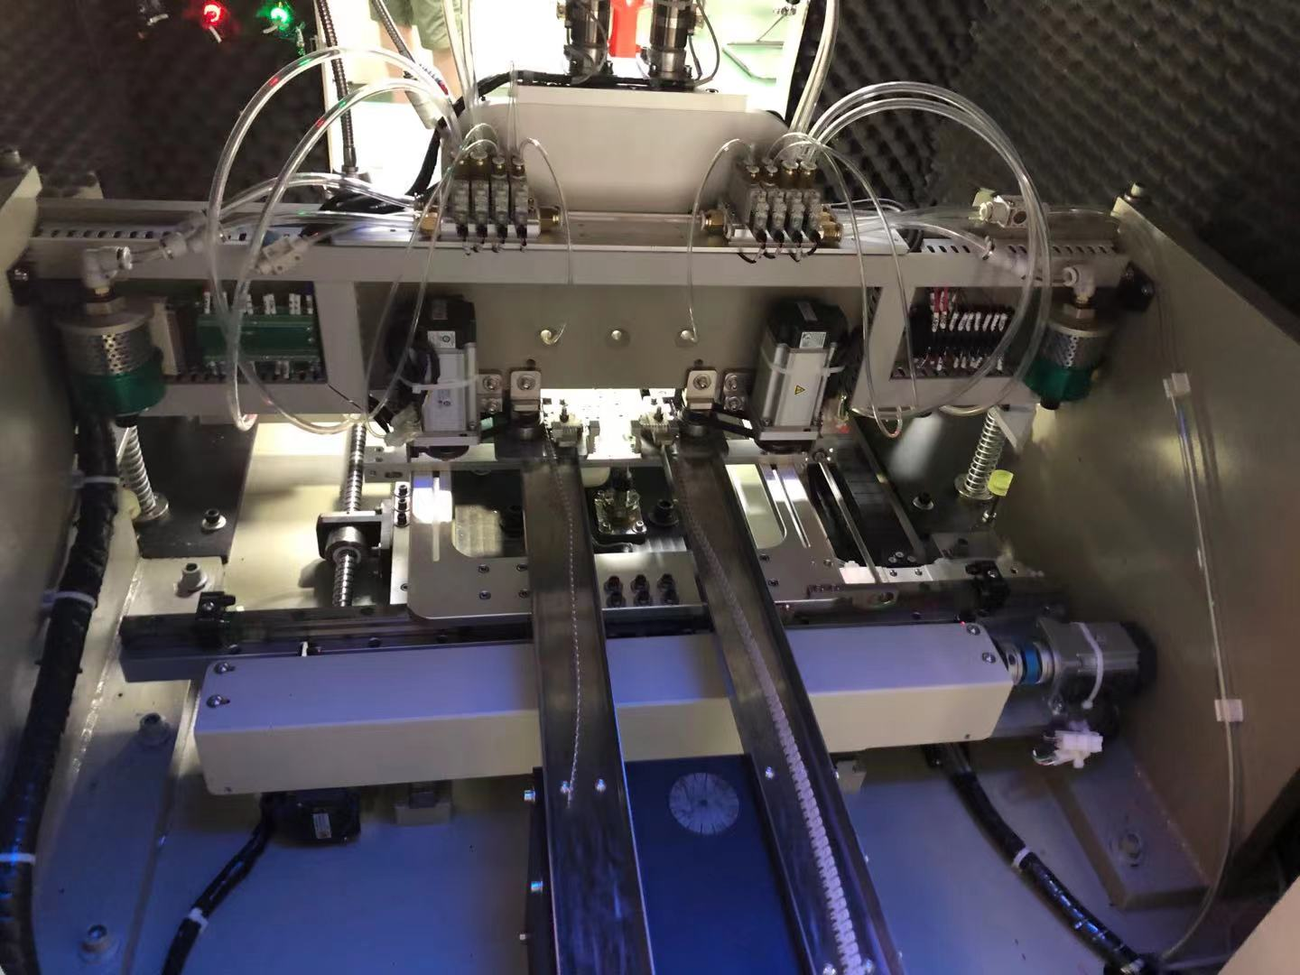

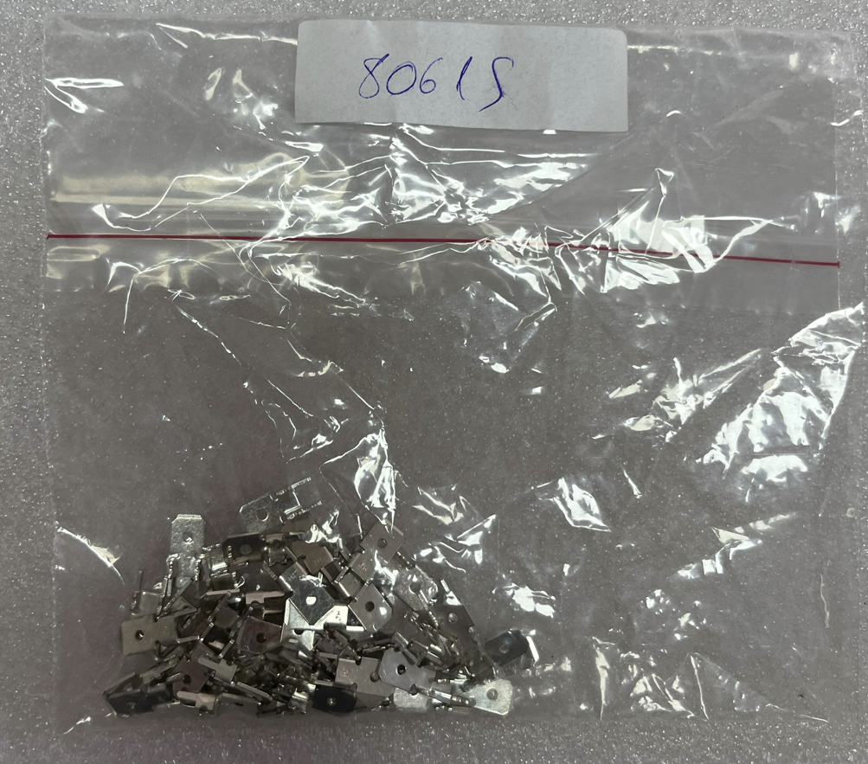
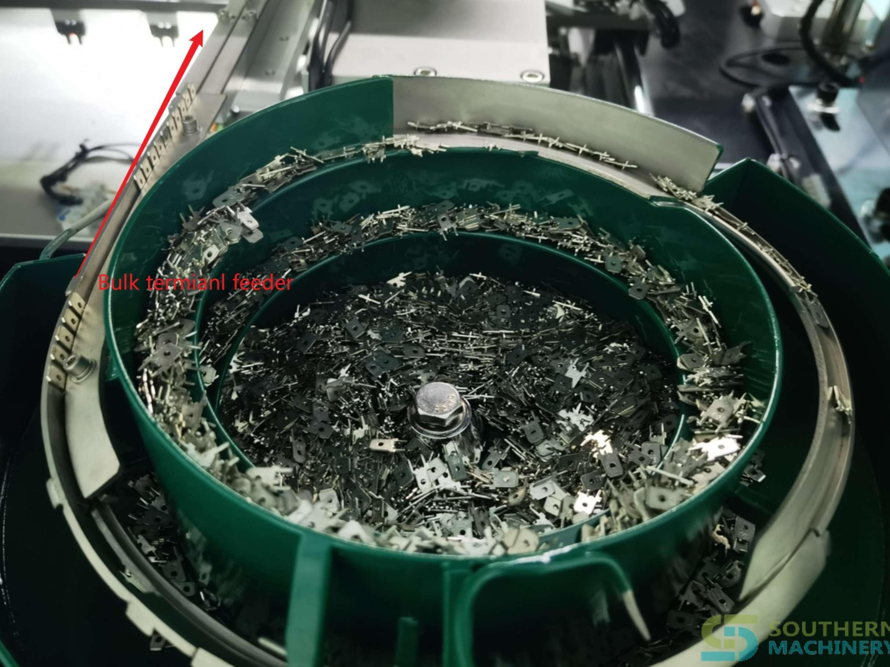
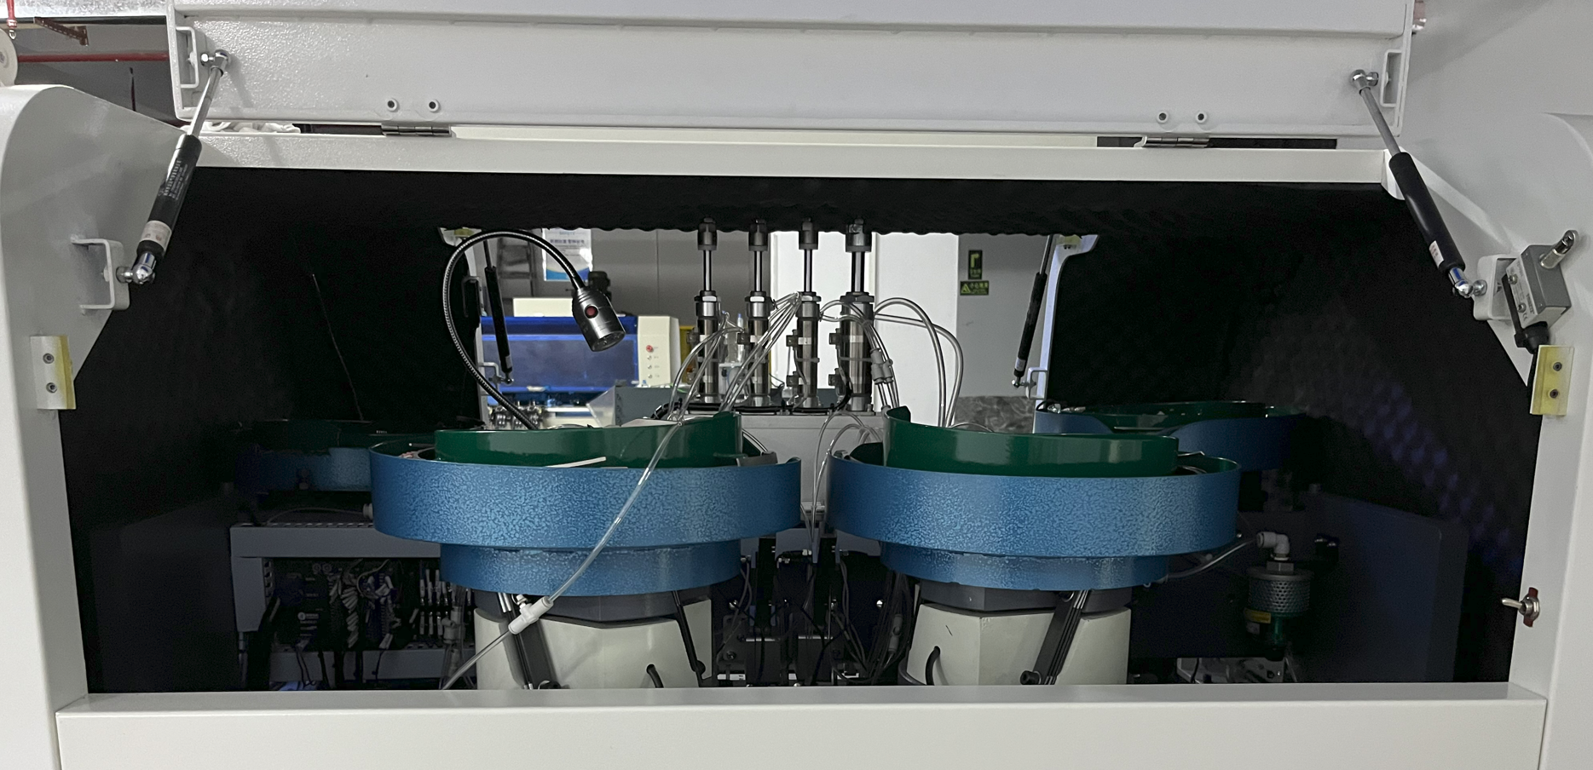
Detail Presentation about S7020T Terminal Insertion Machine
Machine can be equipped with different feeders to transport Terminal Component in different package.
Reel Feeder
Reel Package
Bowl Feeder
Bulk Package(loose)

Slide 10
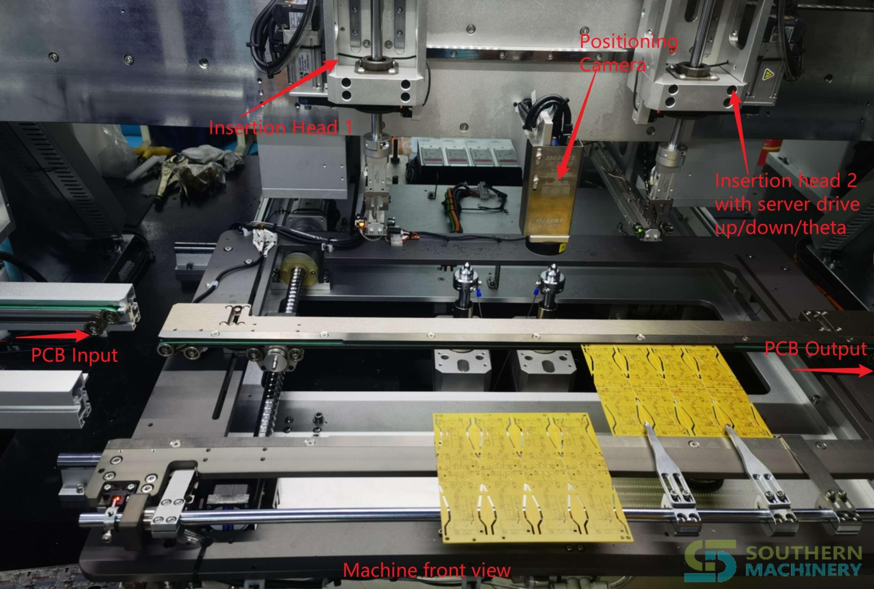
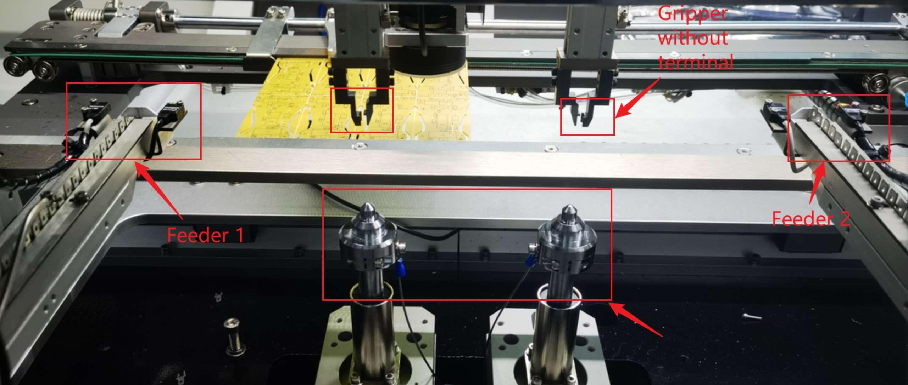
S7020T Terminal Insertion Machine
Machine main sub-assembly
Machine front view
PCB direction: Left to Right
Machine back view

Slide 11
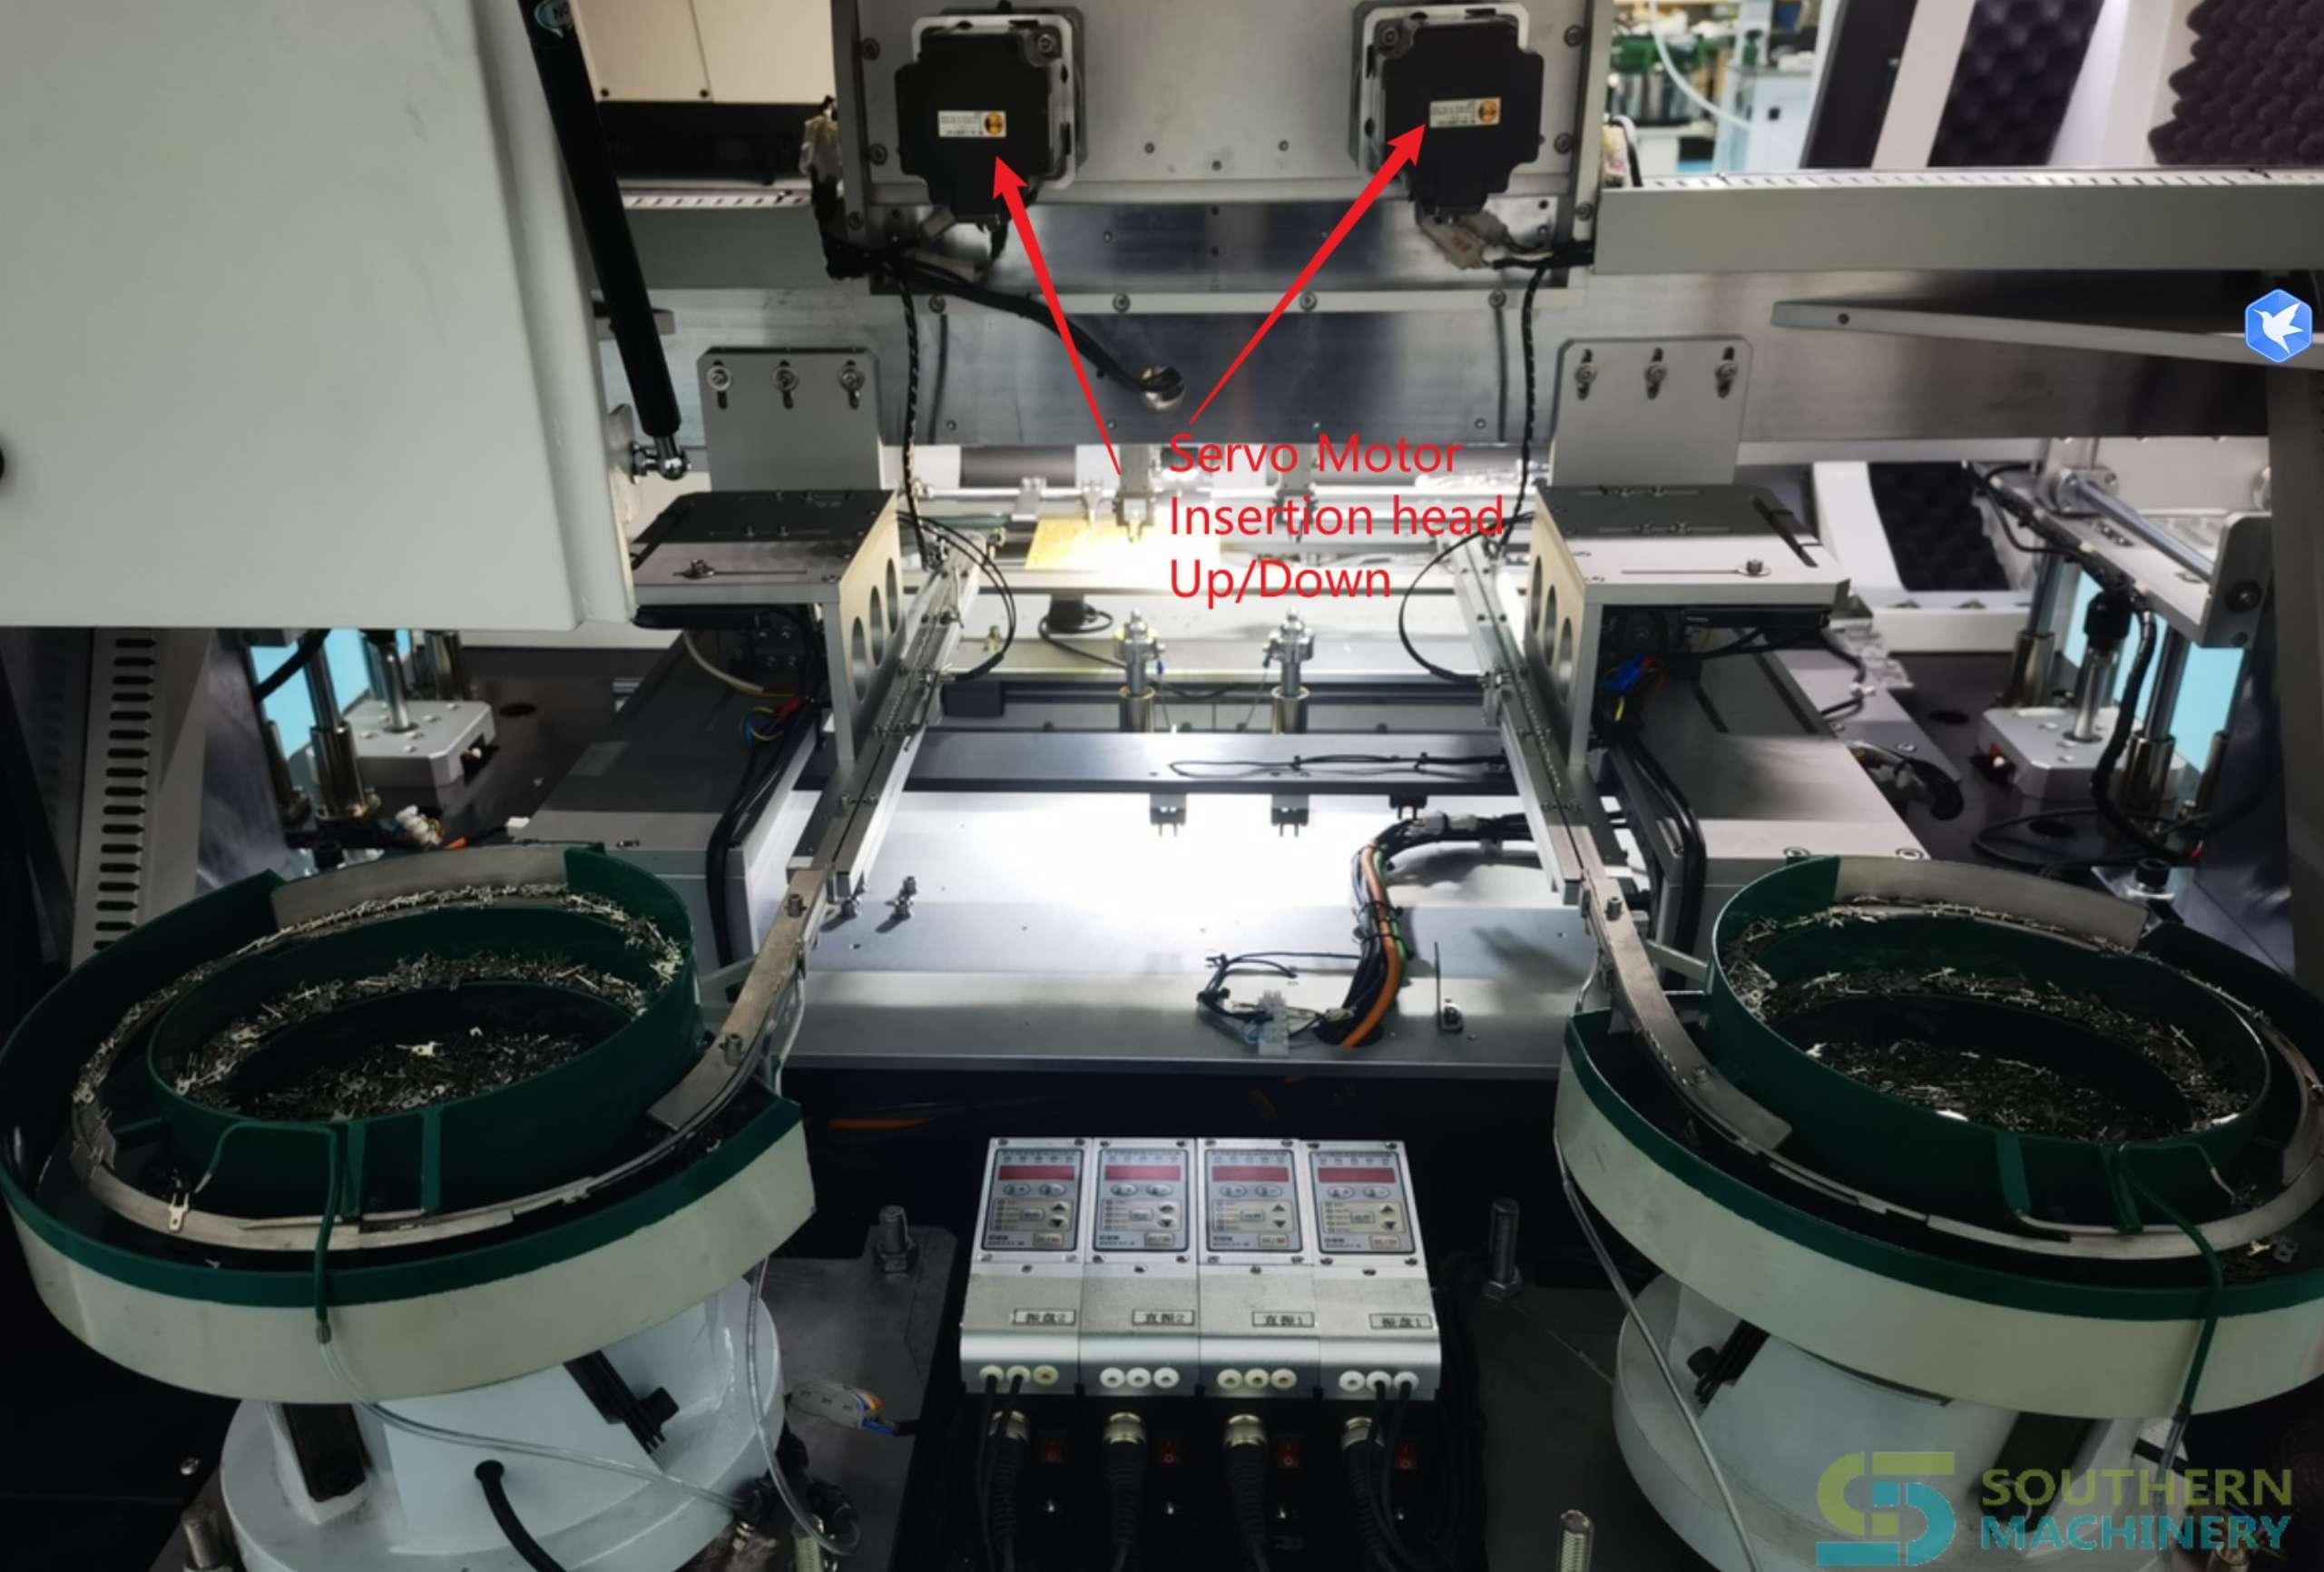
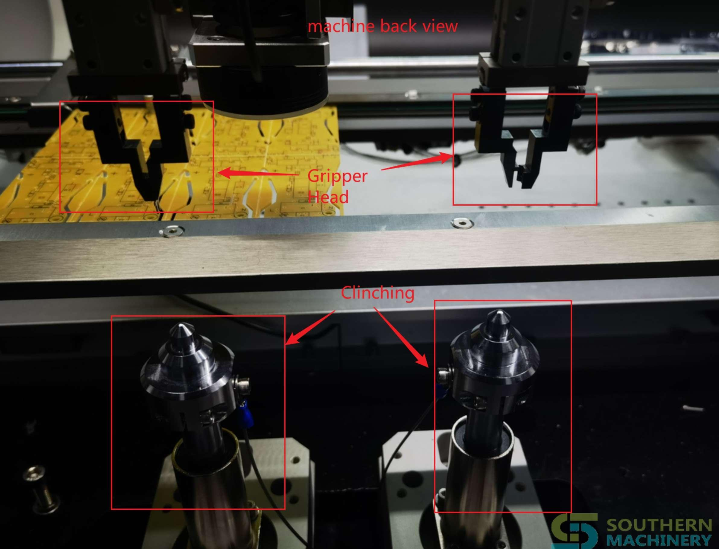
S7020T Terminal Insertion Machine
Machine main sub-assembly

Slide 12


S7020T Terminal Insertion Machine
Insertion processing

Slide 13


S7020T Terminal Insertion Machine
After Insertion

Slide 14



S7020T Terminal Insertion Machine

Slide 15
S7020T Terminal Insertion Machine
Specification
Equipment size | 1700mm*1300mm*1600mm (2 heads)
Material packaging | Terminal in bulk package or reel package
Speed | 12000 CPH
PCB size | 380mm*280mmm (enlarged size can be customized)
Number of insertion heads | 2 insertion heads
terminal thickness | ≥0.5mm ≤1.2mm
Vertical error | ≤0.8°
PCB requirements | The insertion hole is 0.5±0.1mm larger than the component lead
Insertion angle | 360°( increment 1°)
Body distance | The distance between the components ≥ 2mm
Clinch | Inward clinching/Outward clinching
Feeding system | Vibration Bowl Feeder/Reel feeder
Motion accuracy | 0.001mm/pulse
Programming function | Online visual programming, visual correction, EXCEL
Data import | USB interface import, manual entry
Power | Single 220V/AC, 50/60HZ, 2KVA
Equipment weight | 1200KG

Slide 16

S7020P Pin Insertion Machine
Applicable components: Pin
2 insertion heads and 2 reel feeder
S7020P
Speed:12000CPH

Slide 17

S702E Eyelet Insertion Machine
Applicable components: Eyelet
2 insertion heads and 2 bowl feeder
S7020E
Speed:12000CPH

Slide 18

S7020S Tact Switch Insertion machine
Applicable components: Tact Swich
2 insertion heads and 2 bowl feeder
S7020S
Speed:12000CPH

Slide 19








S7020F Odd Form Insertion Machine
Applicable components: Odd form components
2 insertion heads and 2 reel feeder
S7020F
Speed:5000CPH

Slide 20




S7020 Series Insertion Machine
Application industry
Home appliance
Car
Power
Digital watches
Electronic components, etc

Slide 21
Working Video
THT Odd form insertion machine working for Smart EMS factory PCB assembly ：https://youtu.be/aOihpenVfNQ
S7000T TE reel terminal insertion machine for Smart EMS factory PCB assembly：
https://youtu.be/mi1Pf6ZfLWg
Automatically insert bulk FASTON Terminals's solution：
https://youtu.be/XLjedTqB__k
2 heads Bulk or Reel PIN Eyelet Terminal Insertion Machine for Smart EMS factory PCB assembly
https://youtu.be/njBt_XLwvLI
High-speed automatic bulk/tape terminal insertion solution：
https://youtu.be/OD8e-Wx5JcA
Machine 3D drawing:
http://file.autoinsertion.com/SMT%20machine%203D%20Drawing%20in%20Html/S-7020T_Terminal_insertion.html

Slide 22

Working Video - Bulk Terminal Insertion

Slide 23

Working Video - Bulk Terminal Insertion

Slide 24
WELCOME INQUIRY
Please visit
www.smthelp.com
Find us more
https://www.facebook.com/autoinsertion
Know more our team
https://cn.linkedin.com/in/smtsupplier
Welcome to our factory in Shenzhen China
See more machine working video, please Youtube
Auto Insertion
Google
Auto+insertion, to get more informations
Looking forward to your email
info@smthelp.com

